Slide 1
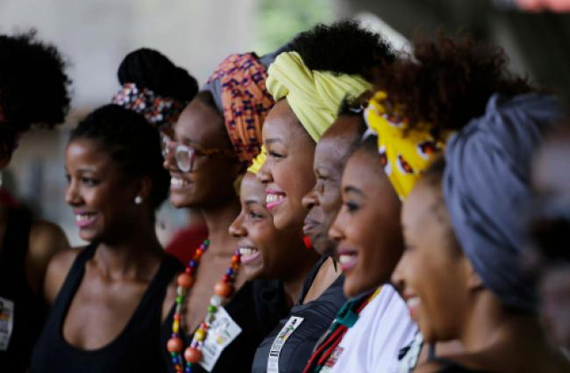
WELCOME
E4A Global Gender Equity Cohort Convening
March 17, 2022

Slide 2
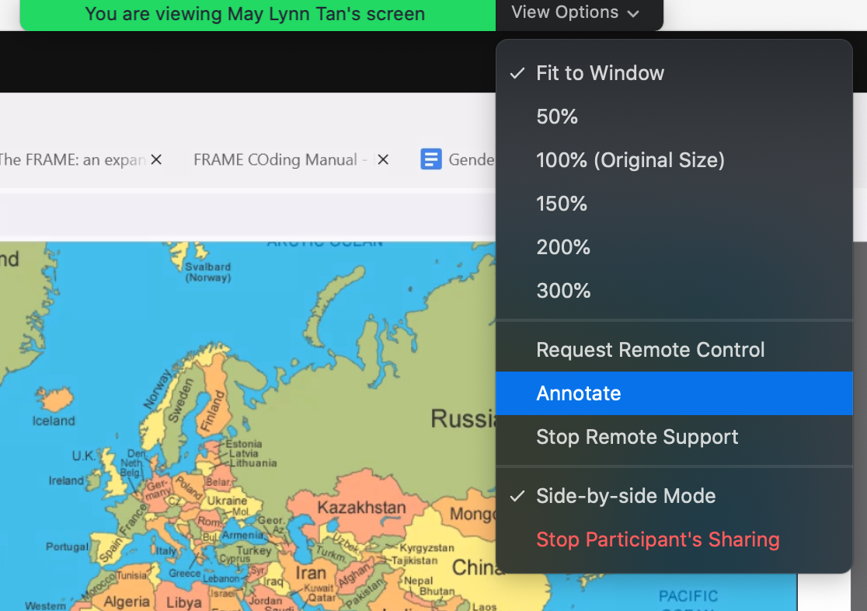

Slide 3
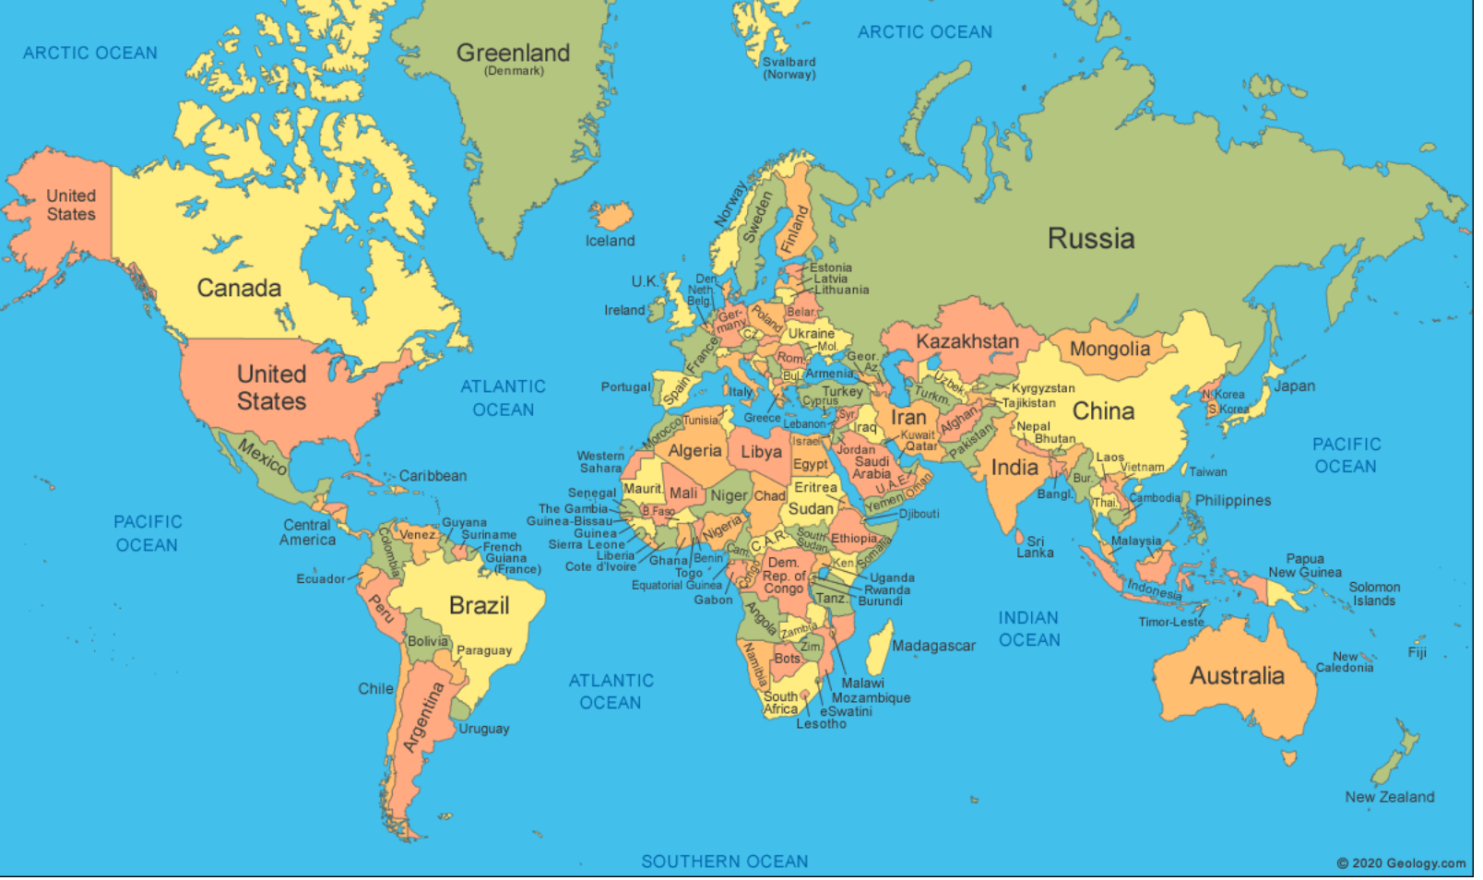

Slide 4

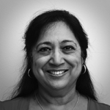
The Power of Evidence Podcast: The Disconnect between “Gender Transformative” Language and Action in Global Health
Key points
Much of the work on gender being done at the periphery (changing women, men, social norms, etc.).
Solutions are needed at the systems / structural level.
Success must be defined in terms of outcomes achieved, not intent.
Focus on aspects of systems that are ripe for change.
Johanna Riha
Anju Malhotra

Slide 5
Discussion Questions
What stood out to you about the podcast episode?
In what ways do you see your project informing systems-level change?
  What are the societal changes needed to sustain or scale the impacts of your intervention?
In your work, do you ever encounter situations in which the value of a program or strategy is judged by its intentions rather than its outcomes?
  How does this impact decision-making?

Slide 6
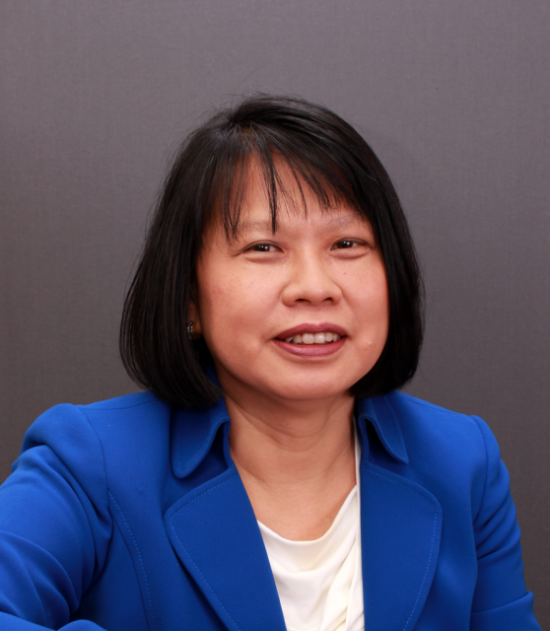
Discussion Questions
Adapting interventions to advance gender and health equity: a review of frameworks and strategies
What stood out to you about Dr. Escoffery’s presentation?
In what ways has your adaptation or implementation framework guided your project?
  Or, in what ways do you expect that it will?
Cam Escoffery

Slide 7
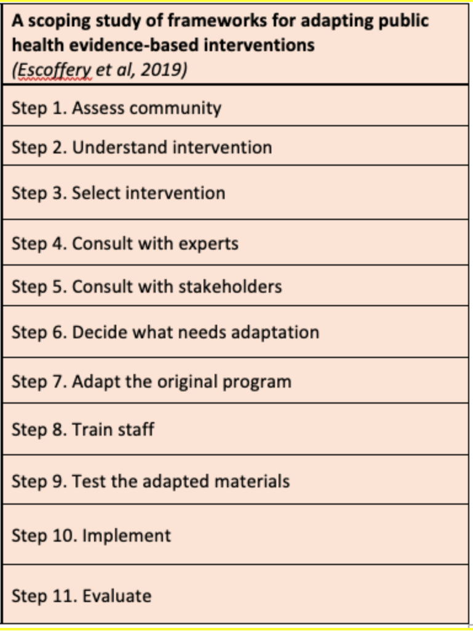
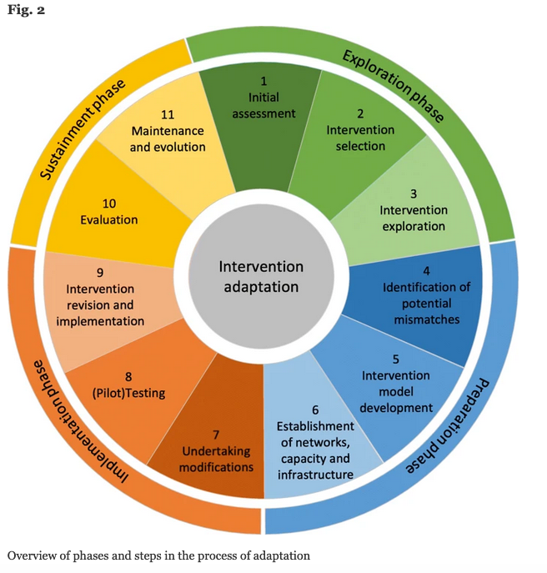
Adapting Interventions
Source: Movsisyan et al. Implementation Science (2019) 14:105

Slide 8
